Slide 1

DYNAMIC
PROGRAMMING

Slide 2
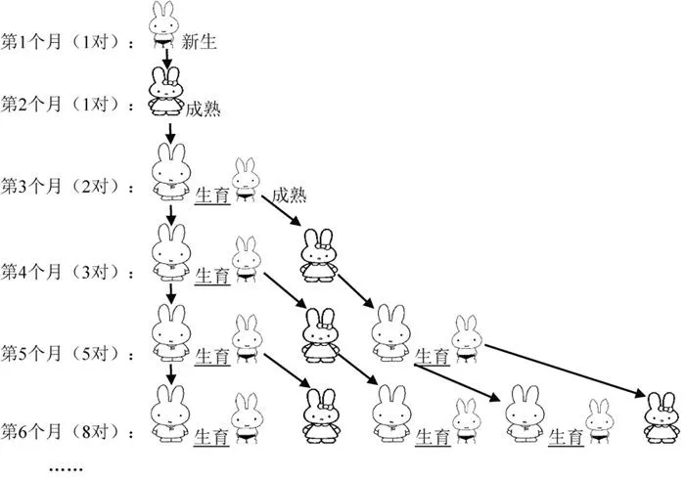
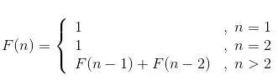
FIBONACCI NUMBERS
The Number of rabbits per month:
1,1,2,3,5,8,13,21,34,…
So
F(1)=1，F(2)=1， F(3)=F(1)+F(2)，F(4)=F(3)+F(2)，

Slide 3

TOP-DOWN
How to design algorithms and write procedure to solve F(n)?
public int fib(int n) {
if (n < 1) {
return -1;
}
if (n == 1 || n == 2) {
return 1;
}
return fib(n - 1) + fib(n - 2);
}
Can we do better ?
Complexity: O(2^{n})

Slide 4
FIBONACCI NUMBERS
There is a lot of double counting. How can it be avoided?
8
6
7
4
5
5
6
2
3
3
4
3
4
4
5
0
1
1
2
1
2
2
3
1
2
2
3
2
3
3
4
1
2
1
2
etc
0
1
0
1
0
1
1
2
0
1
0
1
0
1
1
2
0
1
0
1
0
1
0
1

Slide 5
BOTTOM-UP
First compute the smallest problem
Record the values of F[0] and F[1].
Then compute the bigger ones
Record the value of F[2].
……
Then compute the bigger ones
Record the value of F[n-1].
Compute the final problem
Get F[n].
Complexity: O(n)

Slide 6
OUTLINE
Introduction to Dynamic Programming
Famous Examples
Matrix-chain Multiplication
Longest Common Subsequence
Triangle Decomposition of Convex Polygon
The Optimal Binary Search Trees

Slide 7
INTRODUCTION TO DYNAMIC PROGRAMMING
Why? What?
How?

Slide 8
WHY?
The problem of Divide-and-conquer
Treat the subproblems independently;
If they are dependent, we will calculate redundantly, which leads low efficiency.
Optimization Problem
Given a group of constrains and the cost function, find a solution with the optimal value (min or max) in the solution space;
Lots of the optimization can be divided into subproblems, which are dependent, so the solution of the subproblem can be reused.

Slide 9
WHY?
Those who cannot
remember the past are doomed to repeat it.
-----George Santayana, The life of Reason,
Book I: Introduction and
Reason in Common
Sense (1905)

Slide 10
WHAT
Dynamic Programming
Divide into subproblem
Solve each subproblem only once, store the solutions in a list, and access it when the solution is reused
Bottom-up

Slide 11
WHAT
Elements of dynamic programming
Optimal substructure
A problem exhibits Optimal substructure if an optimal solution to the problem is contained within its optimal solutions to subproblems.
Overlapping subproblems
When a recursive algorithm revisits the same problem over and over again, we say that the optimization problem has overlapping subproblems.

Slide 12
OPTIMAL SUBSTRUCTURE
1） Show that a solution to the problem consists of making a choice.
2） Suppose the choices are known.
3） Determine which subproblems ensue.
4） Cut-and-paste.

Slide 13
HOW?
The step of dynamic programming:
Characterize the structure of an optimal solution
Recursively define the value of an optimal solution
Compute the value of an optimal solution in a bottom-up fashion
Construct an optimal solution from computed information

Slide 14
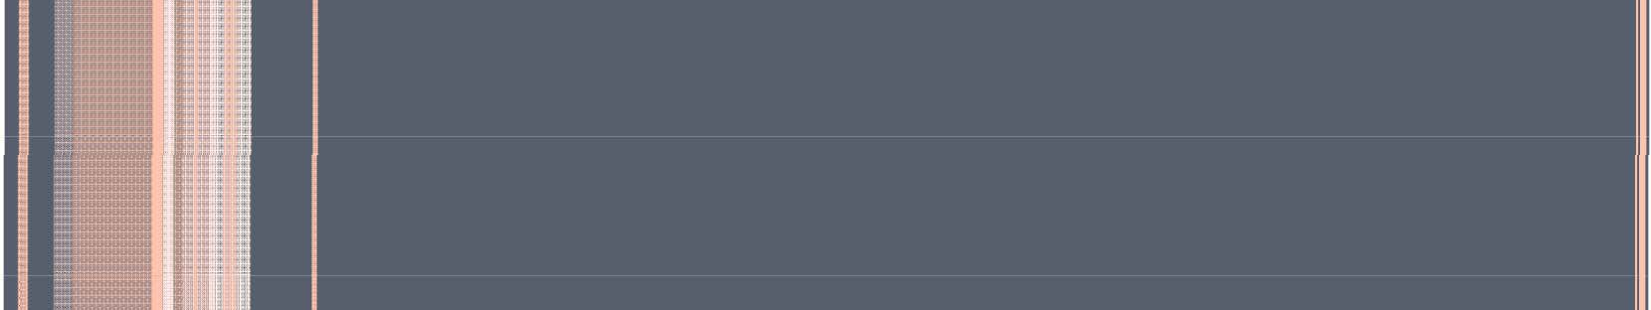

MATRIX-CHAIN MULTIPLICATION

Slide 15
PROBLEM DEFINITION
Inputs: Matrix chain < A₁, A₂ ,..., A_{n} >
Outputs: A₁A₂...A_{n}
If A is a p×q matrix, and B a q×r matrix, then normally we spend O(pqr) times to compute AB.

Slide 16
MOTIVATION
Matrix multiplication fulfill multiplication associativity.
Example:
( A₁ A₂ A₃ A₄ )
= ( A₁ ( A₂ (A₃ A₄) ) )
= (( A₁ A₂ ) ( A₃ A₄ ) )
....
= ( ( ( A₁A₂ ) A₃ ) A₄ )

Slide 17
MULTIPLICATION ORDER
The complexity depends on the order
Suppose A₁ a 10×100 matrix, A₂ a 100 × 5 matrix, A₃ a 5×50 matrix
T( ( A₁ A₂ ) A₃ )=10 × 100 × 5 + 10 × 5 × 50=7500
T( A₁ ( A₂ A₃ ))= 100 × 5 × 50+10 × 100 × 50=750000

Slide 18
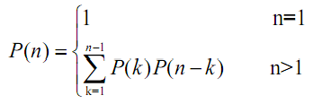
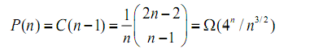
SOLUTION SPACE
Denote the number of different solutions as P(n), the recursive function of P(n)
P(n) is Catalan number
P(n) is so big to solute the problem through enumeration methods.

Slide 19
SOLUTION SPACE
Denote the number of different solutions as P(n), the recursive function of P(n)
P(n) is Catalan number
P(n) is so big to solute the problem through enumeration methods.
Enumerating
won’t work

Slide 20
STEP 1: STRUCTURE OF OPTIMAL SOLUTION
Denote the multiplication A_{i} A_{i +1}...A_{j} as A [i: j]
Suppose we cut at k, and get a optimal order
( A₁ A₂ ...A_{n} ) = (( A₁...A_{k} )( A_{k +1}...A_{n} ))
A [1:n]=A [1:k] A [k+1:n]
we can prove A [1:k] and A [k+1:n] are optimal order too

Slide 21
MULTIPLICATION ORDER
The complexity depends on the order
Suppose A₁ a 10×100 matrix, A₂ a 100 × 5 matrix, A₃ a 5×50 matrix
T( ( A₁ A₂ ) A₃ )=10 × 100 × 5 + 10 × 5 × 50=7500
T( A₁ ( A₂ A₃ ))= 100 × 5 × 50+10 × 100 × 50=750000

Slide 22
OVERLAPPING
A₁×A₂×A₃×A₄
(A₁)×(A₂×A₃×A₄)
(A₁×A₂)×(A₃×A₄)
(A₁×A₂×A₃)×(A₄)
(A₂×A₃)
(A₃×A₄)
(A₁×A₂)
(A₃×A₄)
(A₁×A₂)
(A₂×A₃)

Slide 23
STEP 2: RECURSION
Denotation
m[ i, j] ----the minimal cost(times) to calculate A [i:j]
m[1, n] ----the minimal cost(times) to calculate A [1:n]
Recursion of cost
m[i, j] = 0
if i=j if i<j
m[i, j] = mini≤ k<j{m[i, k ] + m[k + 1, j] + pi -1 pk pj }

Slide 24
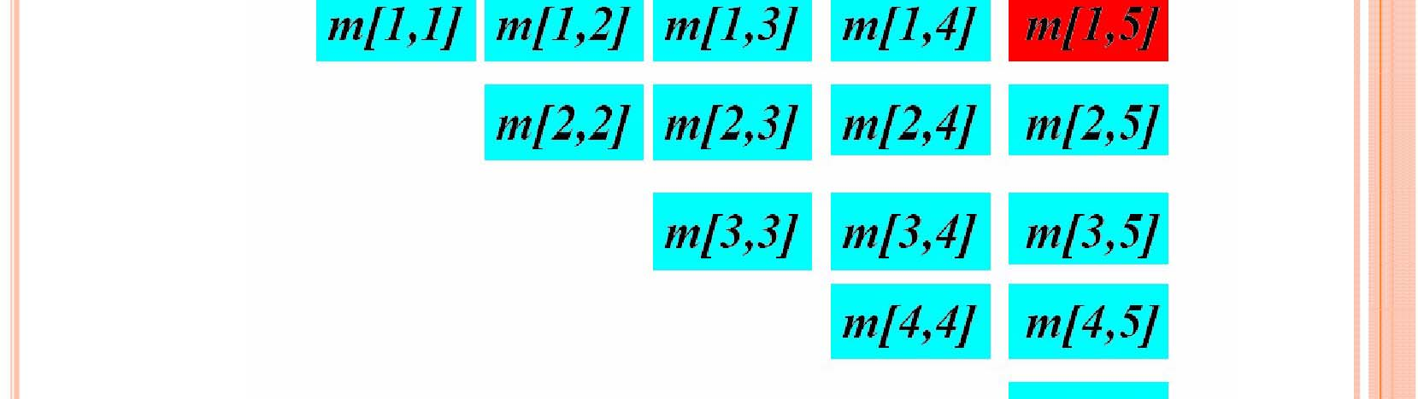
EXAMPLE
m[1,5] = min₁ _{≤ k <5} {m[1, k ] + m[k + 1,5] + p₀ p_{k} p₅ }
m[2, 2] + m[3, 4] + p₁ p₂ p₄ m[2,3] + m[4, 4] + p₁ p₃ p₄
m[2, 4] = min

Slide 25
STEP 3 BOTTOM-UP
public static void matrixChain(int [] p, int [][] m, int [][] s)
{
int n=p.length-1;
for (int i = 1; i <= n; i++) m[i][i] = 0;
for (int r = 2; r <= n; r++)
for (int i = 1; i <= n - r+1; i++) {
int j=i+r-1;
m[i][j] = m[i+1][j]+ p[i-1]*p[i]*p[j];
s[i][j] = i;
for (int k = i+1; k < j; k++) {
int t = m[i][k] + m[k+1][j] + p[i-1]*p[k]*p[j];
if (t < m[i][j]) {
m[i][j] = t;
s[i][j] = k;}
}
}
}

Slide 26
STEP 3 BOTTOM-UP
public static void matrixChain(int [] p, int [][] m, int [][] s)
{
int n=p.length-1;
for (int i = 1; i <= n; i++) m[i][i] = 0;
for (int r = 2; r <= n; r++)
for (int i = 1; i <= n - r+1; i++) {
int j=i+r-1;
m[i][j] = m[i+1][j]+ p[i-1]*p[i]*p[j];
s[i][j] = i;
for (int k = i+1; k < j; k++) {
int t = m[i][k] + m[k+1][j] + p[i-1]*p[k]*p[j];
if (t < m[i][j]) {
m[i][j] = t;
s[i][j] = k;}
}
}
}
Complexity:
It is based on the ternary recurrence of r, i, k. So the time complexity is O(n³) while the space complexity is O(n²).

Slide 27
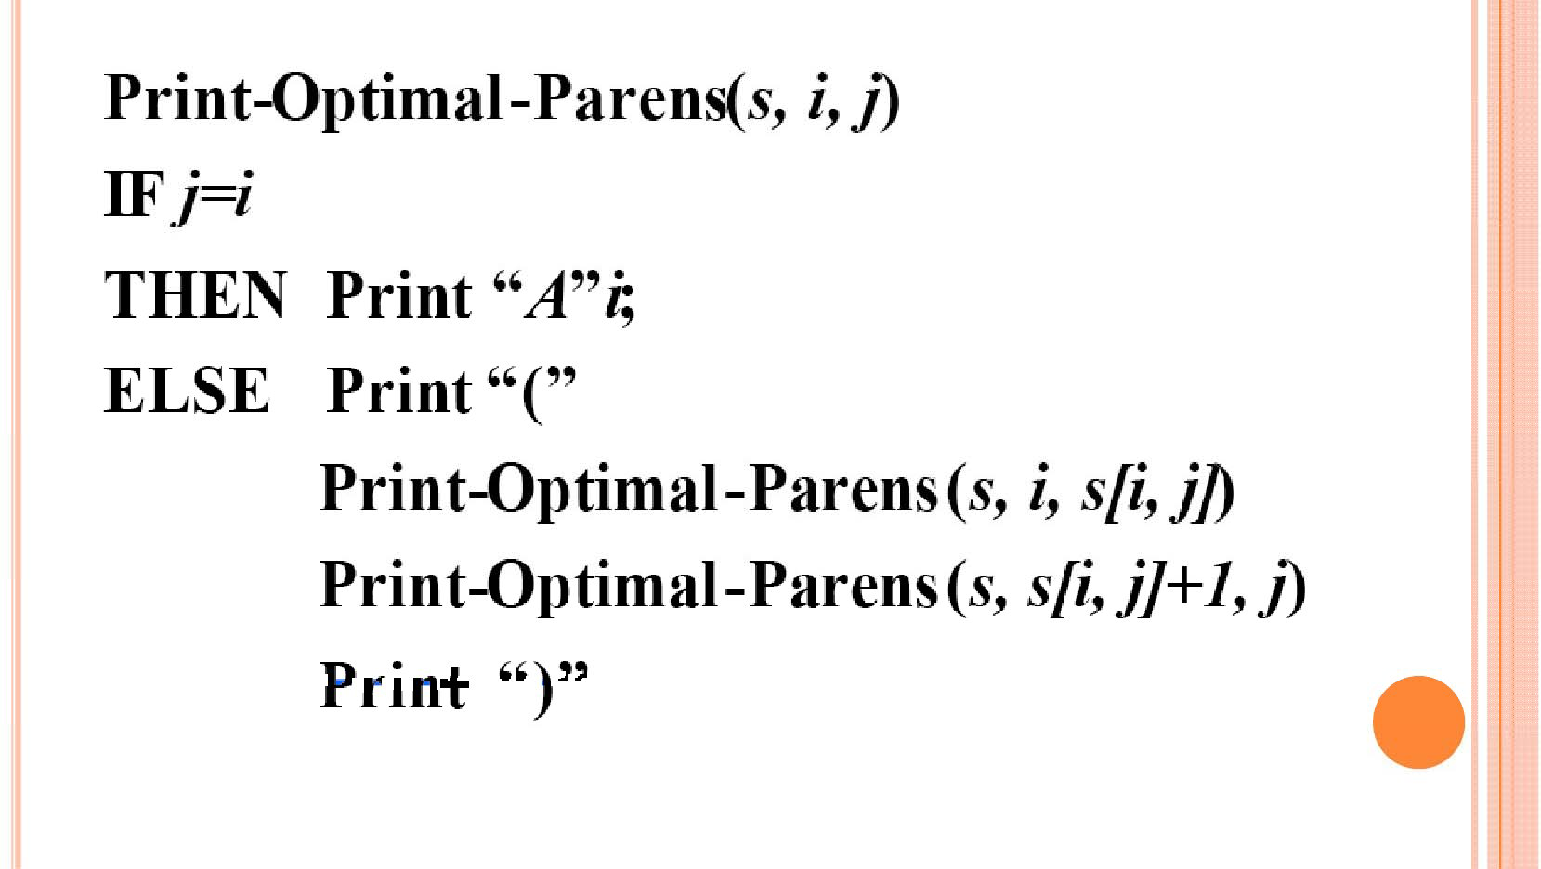
STEP 4 CONSTRUCTING

Slide 28
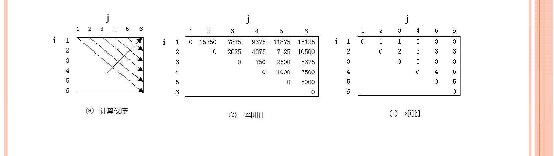
EXAMPLE
A1 | A2 | A3 | A4 | A5 | A6
30×35 | 35×15 | 15×5 | 5×10 | 10×20 | 20×25
m[2][2] + m[3][5] + p1 p2 p5 = 0 + 2500 + 35 × 15 × 20 = 13000
m[2][5] = min m[2][3] + m[4][5] + p1 p3 p5 = 2625 + 1000 + 35 × 5 × 20 = 7125
m[2][4] + m[5][5] + p1 p4 p5 = 4375 + 0 + 35 × 10 × 20 = 11375

Slide 29
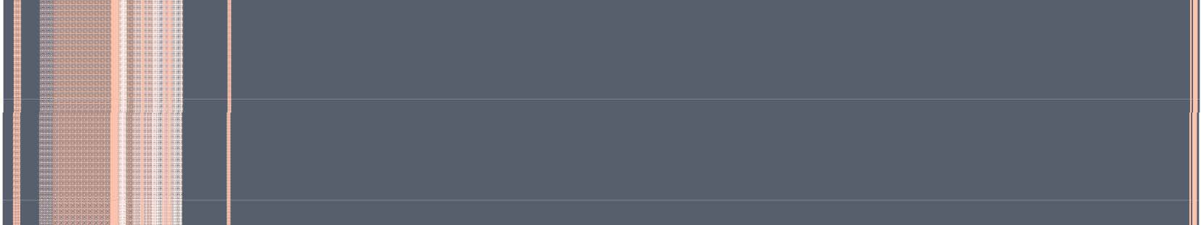
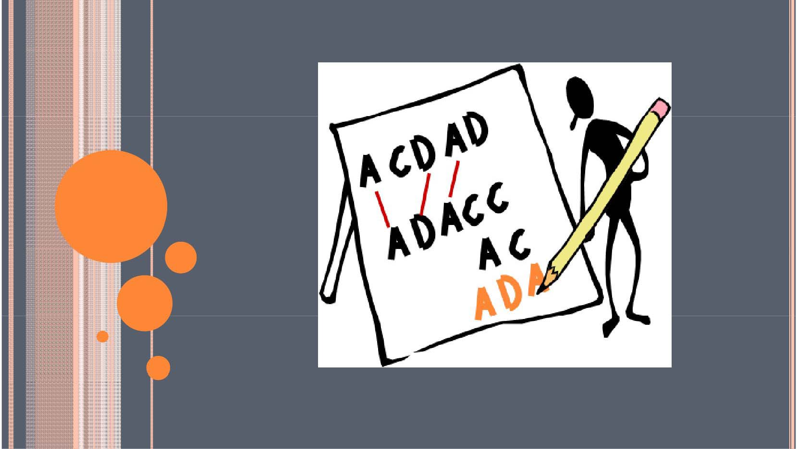
LONGEST COMMON SEQUENCE

Slide 30
LONGEST COMMON SUSEQUENCE (LCS)
Definition
Characterizing LCS
Recursive solution
Bottom-up to computing the length of LCS
Construct Optimal solution

Slide 31
DEFINITION
Subsequence
Definition:
A sequence Z =< z1 , z2 ,..., zk > is a subsequence of X =< x1 , x2 ,..., xm >
if there exists a strictly increasing sequence< i1 , i2 ,..., ik > of indices of X
such that for all j=1,2,…,k, we have xi j = z j
Example:
Z=<A,B,C,D> is a subsequence of X=<A,C,B,C,A,D> with corresponding index sequence <1,3,4,6>.
Common subsequence
We say that a sequence Z is a common subsequence of X and Y if Z is a subsequence of both X and Y.
The longest-common-subsequence problem(LCS): Input: X =< x1 , x2 ,..., xm > Y =< y1 , y2 ,..., yn >
Output: the common subsequence Z that max(|Z|)

Slide 32
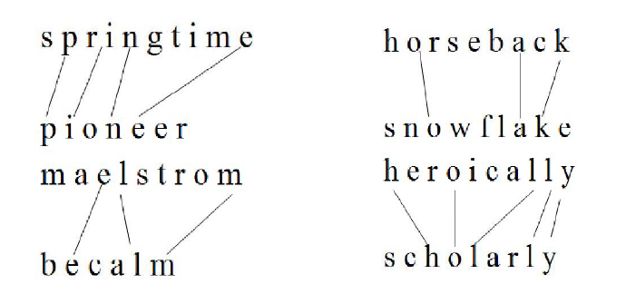
EXAMPLE

Slide 33
EXAMPLE
Brute-force algorithm:
For every subsequence of X, check whether it’s a subsequence of Y.
Time: Θ(n2^{m})
Subsequence
Definition:
A sequence Z =< z1 , z2 ,..., zk > is a subsequence of X =< x1 , x2 ,..., xm >
if there exists a strictly increasing sequence< i1 , i2 ,..., ik > of indices of X
such that for all j=1,2,…,k, we have xi j = z j
Example:
Z=<A,B,C,D> is a subsequence of X=<A,C,B,C,A,D> with corresponding index sequence <1,3,4,6>.
Common subsequence
We say that a sequence Z is a common subsequence of X and Y if Z is a subsequence of both X and Y.
The longest-common-subsequence problem(LCS): Input: X =< x1 , x2 ,..., xm > Y =< y1 , y2 ,..., yn >
Output: the common subsequence Z that max(|Z|)

Slide 34
CHARACTERIZING LCS
The ith prefix of X----- X_{i}
Given X =< x₁ , x₂ ,..., x_{m} > , the ith prefix of X is
X _{i} =< x₁ , x₂ ,..., x_{i} >
Example
X=(A, B, D, C, A)
X₁=(A), X₂=(A, B), X₃=(A, B, D)

Slide 35
CHARACTERIZING LCS
Optimal substructure of an LCS
Let X =< x₁ , x₂ ,..., x_{m} > , Y =< y₁ , y₂ ,..., y_{n} > be sequences, and
let Z =< z₁ , z₂ ,..., z_{k} > be any LCS of X and Y.
If xm = yn , then zk =xm =yn and Zk -1 is an LCS of Xm-1 and Yn-1
If xm ≠ yn , then zk ≠ xm implies that Z is an LCS of X m-1 and Y
If xm ≠ yn , then zk ≠ yn implies that Z is an LCS of X and Yn-1

Slide 36
RECURSIVE SOLUTION
Define c[i, j] as the length of an LCS of the sequences Xi
and Yj
The recursive formula is
0
c[i－1, j－ 1] + 1
if i = 0 or j = 0
if i, j > 0 and xi = y j
c[i, j ] =
Max(c[i, j－1], c[i－1, j ]) if i, j > 0 and xi ≠ y j

Slide 37
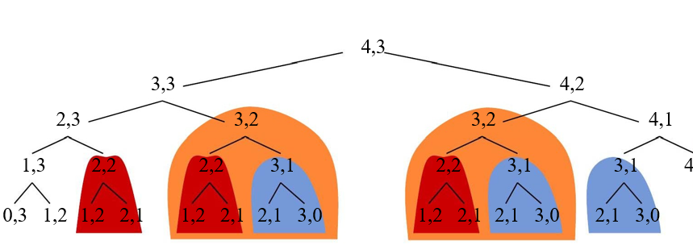
RECURSIVE SOLUTION
We could write a recursive algorithm based on this formulation.
Try with “bozo”, “bat”.
4,0
Lots of repeated subproblems.
Instead of recomputing, store in a table.

Slide 38
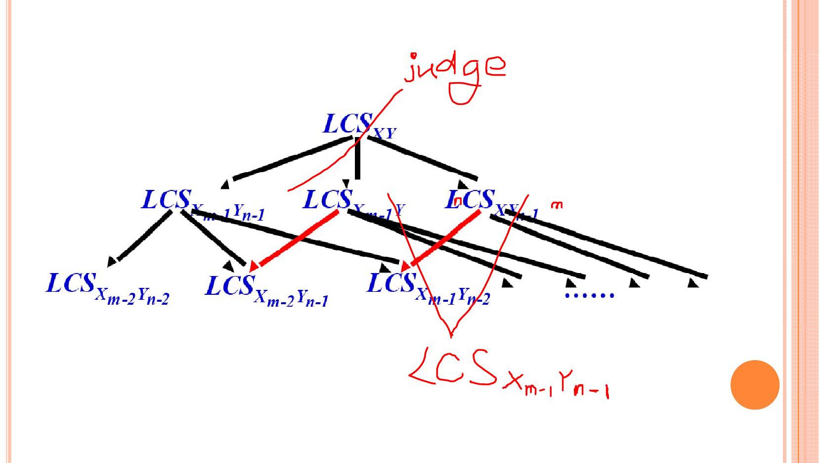
OVERLAPPING

Slide 39

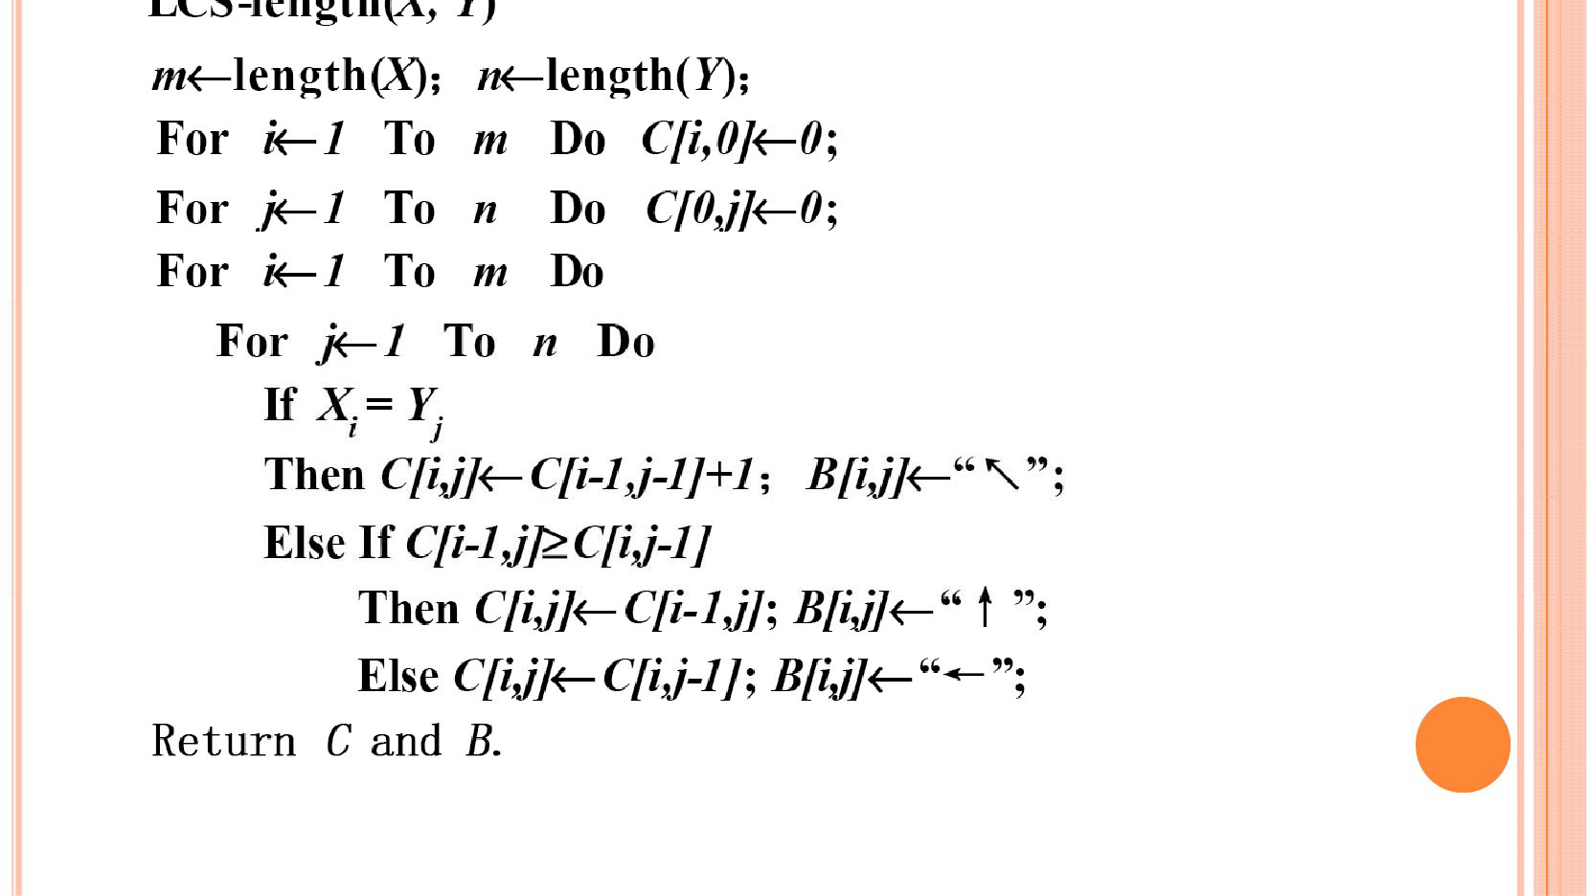
COMPUTING THE LENGTH OF AN LCS

Slide 40
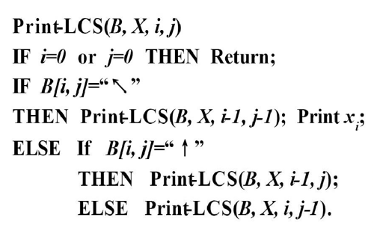
CONSTRUCTING AN LCS
Initial call is PRINT-
LCS (B, X, m, n)
B[i, j] points to table entry whose subproblem we used in solving LCS of Xi and Y j .
When b[i , j] = ,we have extended LCS by one character. So longest common subsequence = entries With in them.
↑
↑

Slide 41
Demonstration
 | j | 0 | 1 | 2 | 3 | 4 | 5 | 6 | 7 | 8 | 9 | 10
i |  | y_{j} | a | m | p | u | t | a | t | i | o | n
0 | x_{i}
1 | s
2 | p
3 | a
4 | n
5 | k
6 | i
7 | n
8 | g
 | 0 | 0 | 0 | 0 | 0 | 0 | 0 | 0 | 0 | 0
0
0
0
0
0
0
0
0

Slide 42
Demonstration
 | j | 0 | 1 | 2 | 3 | 4 | 5 | 6 | 7 | 8 | 9 | 10
i |  | y_{j} | a | m | p | u | t | a | t | i | o | n
0 | x_{i}
1 | s
2 | p
3 | a
4 | n
5 | k
6 | i
7 | n
8 | g
 | 0 | 0 | 0 | 0 | 0 | 0 | 0 | 0 | 0 | 0
0 | 0↑ | 0↑ | 0↑ | 0↑ | 0↑ | 0↑ | 0↑ | 0↑ | 0↑ | 0↑
0
0
0
0
0
0
0

Slide 43
Demonstration
 | j | 0 | 1 | 2 | 3 | 4 | 5 | 6 | 7 | 8 | 9 | 10
i |  | y_{j} | a | m | p | u | t | a | t | i | o | n
0 | x_{i}
1 | s
2 | p
3 | a
4 | n
5 | k
6 | i
7 | n
8 | g
 | 0 | 0 | 0 | 0 | 0 | 0 | 0 | 0 | 0 | 0
0 | 0↑ | 0↑ | 0↑ | 0↑ | 0↑ | 0↑ | 0↑ | 0↑ | 0↑ | 0↑
0 | 0↑ | 0↑ | 1 | 1← | 1← | 1← | 1← | 1← | 1← | 1←
0
0
0
0
0
0
↑

Slide 44
Demonstration
 | j | 0 | 1 | 2 | 3 | 4 | 5 | 6 | 7 | 8 | 9 | 10
i |  | y_{j} | a | m | p | u | t | a | t | i | o | n
0 | x_{i}
1 | s
2 | p
3 | a
4 | n
5 | k
6 | i
7 | n
8 | g
 | 0 | 0 | 0 | 0 | 0 | 0 | 0 | 0 | 0 | 0
0 | 0↑ | 0↑ | 0↑ | 0↑ | 0↑ | 0↑ | 0↑ | 0↑ | 0↑ | 0↑
0 | 0↑ | 0↑ | 1 | 1← | 1← | 1← | 1← | 1← | 1← | 1←
0 | 1 | 1← | 1↑ | 1↑ | 1↑ | 2 | 2← | 2← | 2← | 2←
0
0
0
0
0
↑
↑
↑

Slide 45
Demonstration
 | j | 0 | 1 | 2 | 3 | 4 | 5 | 6 | 7 | 8 | 9 | 10
i |  | y_{j} | a | m | p | u | t | a | t | i | o | n
0 | x_{i}
1 | s
2 | p
3 | a
4 | n
5 | k
6 | i
7 | n
8 | g
 | 0 | 0 | 0 | 0 | 0 | 0 | 0 | 0 | 0 | 0
0 | 0↑ | 0↑ | 0↑ | 0↑ | 0↑ | 0↑ | 0↑ | 0↑ | 0↑ | 0↑
0 | 0↑ | 0↑ | 1 | 1← | 1← | 1← | 1← | 1← | 1← | 1←
0 | 1 | 1← | 1↑ | 1↑ | 1↑ | 2 | 2← | 2← | 2← | 2←
0 | 1↑ | 1↑ | 1↑ | 1↑ | 1↑ | 2↑ | 2↑ | 2↑ | 2↑ | 3
0
0
0
0
↑
↑
↑
↑

Slide 46
Demonstration
 | j | 0 | 1 | 2 | 3 | 4 | 5 | 6 | 7 | 8 | 9 | 10
i |  | y_{j} | a | m | p | u | t | a | t | i | o | n
0 | x_{i}
1 | s
2 | p
3 | a
4 | n
5 | k
6 | i
7 | n
8 | g
 | 0 | 0 | 0 | 0 | 0 | 0 | 0 | 0 | 0 | 0
0 | 0↑ | 0↑ | 0↑ | 0↑ | 0↑ | 0↑ | 0↑ | 0↑ | 0↑ | 0↑
0 | 0↑ | 0↑ | 1 | 1← | 1← | 1← | 1← | 1← | 1← | 1←
0 | 1 | 1← | 1↑ | 1↑ | 1↑ | 2 | 2← | 2← | 2← | 2←
0 | 1↑ | 1↑ | 1↑ | 1↑ | 1↑ | 2↑ | 2↑ | 2↑ | 2↑ | 3
0 | 1↑ | 1↑ | 1↑ | 1↑ | 1↑ | 2↑ | 2↑ | 2↑ | 2↑ | 3↑
0
0
0
↑
↑
↑
↑

Slide 47
Demonstration
 | j | 0 | 1 | 2 | 3 | 4 | 5 | 6 | 7 | 8 | 9 | 10
i |  | y_{j} | a | m | p | u | t | a | t | i | o | n
0 | x_{i}
1 | s
2 | p
3 | a
4 | n
5 | k
6 | i
7 | n
8 | g
 | 0 | 0 | 0 | 0 | 0 | 0 | 0 | 0 | 0 | 0
0 | 0↑ | 0↑ | 0↑ | 0↑ | 0↑ | 0↑ | 0↑ | 0↑ | 0↑ | 0↑
0 | 0↑ | 0↑ | 1 | 1← | 1← | 1← | 1← | 1← | 1← | 1←
0 | 1 | 1← | 1↑ | 1↑ | 1↑ | 2 | 2← | 2← | 2← | 2←
0 | 1↑ | 1↑ | 1↑ | 1↑ | 1↑ | 2↑ | 2↑ | 2↑ | 2↑ | 3
0 | 1↑ | 1↑ | 1↑ | 1↑ | 1↑ | 2↑ | 2↑ | 2↑ | 2↑ | 3↑
0 | 1↑ | 1↑ | 1↑ | 1↑ | 1↑ | 2↑ | 2↑ | 3 | 3← | 3↑
0
0
↑
↑
↑
↑
↑

Slide 48
Demonstration
 | j | 0 | 1 | 2 | 3 | 4 | 5 | 6 | 7 | 8 | 9 | 10
i |  | y_{j} | a | m | p | u | t | a | t | i | o | n
0 | x_{i}
1 | s
2 | p
3 | a
4 | n
5 | k
6 | i
7 | n
8 | g
 | 0 | 0 | 0 | 0 | 0 | 0 | 0 | 0 | 0 | 0
0 | 0↑ | 0↑ | 0↑ | 0↑ | 0↑ | 0↑ | 0↑ | 0↑ | 0↑ | 0↑
0 | 0↑ | 0↑ | 1 | 1← | 1← | 1← | 1← | 1← | 1← | 1←
0 | 1 | 1← | 1↑ | 1↑ | 1↑ | 2 | 2← | 2← | 2← | 2←
0 | 1↑ | 1↑ | 1↑ | 1↑ | 1↑ | 2↑ | 2↑ | 2↑ | 2↑ | 3
0 | 1↑ | 1↑ | 1↑ | 1↑ | 1↑ | 2↑ | 2↑ | 2↑ | 2↑ | 3↑
0 | 1↑ | 1↑ | 1↑ | 1↑ | 1↑ | 2↑ | 2↑ | 3 | 3← | 3↑
0 | 1↑ | 1↑ | 1↑ | 1↑ | 1↑ | 2↑ | 2↑ | 3↑ | 3↑ | 4
0
↑
↑
↑
↑
↑
↑

Slide 49
Demonstration
 | j | 0 | 1 | 2 | 3 | 4 | 5 | 6 | 7 | 8 | 9 | 10
i |  | y_{j} | a | m | p | u | t | a | t | i | o | n
0 | x_{i}
1 | s
2 | p
3 | a
4 | n
5 | k
6 | i
7 | n
8 | g
 | 0 | 0 | 0 | 0 | 0 | 0 | 0 | 0 | 0 | 0
0 | 0↑ | 0↑ | 0↑ | 0↑ | 0↑ | 0↑ | 0↑ | 0↑ | 0↑ | 0↑
0 | 0↑ | 0↑ | 1 | 1← | 1← | 1← | 1← | 1← | 1← | 1←
0 | 1 | 1← | 1↑ | 1↑ | 1↑ | 2 | 2← | 2← | 2← | 2←
0 | 1↑ | 1↑ | 1↑ | 1↑ | 1↑ | 2↑ | 2↑ | 2↑ | 2↑ | 3
0 | 1↑ | 1↑ | 1↑ | 1↑ | 1↑ | 2↑ | 2↑ | 2↑ | 2↑ | 3↑
0 | 1↑ | 1↑ | 1↑ | 1↑ | 1↑ | 2↑ | 2↑ | 3 | 3← | 3↑
0 | 1↑ | 1↑ | 1↑ | 1↑ | 1↑ | 2↑ | 2↑ | 3↑ | 3↑ | 4
0 | 1↑ | 1↑ | 1↑ | 1↑ | 1↑ | 2↑ | 2↑ | 3↑ | 3↑ | 4↑
↑
↑
↑
↑
↑
↑

Slide 50
Demonstration
 | j | 0 | 1 | 2 | 3 | 4 | 5 | 6 | 7 | 8 | 9 | 10
i |  | y_{j} | a | m | p | u | t | a | t | i | o | n
0 | x_{i}
1 | s
2 | p
3 | a
4 | n
5 | k
6 | i
7 | n
8 | g
 | 0 | 0 | 0 | 0 | 0 | 0 | 0 | 0 | 0 | 0
0 | 0↑ | 0↑ | 0↑ | 0↑ | 0↑ | 0↑ | 0↑ | 0↑ | 0↑ | 0↑
0 | 0↑ | 0↑ | 1 | 1← | 1← | 1← | 1← | 1← | 1← | 1←
0 | 1 | 1← | 1↑ | 1↑ | 1↑ | 2 | 2← | 2← | 2← | 2←
0 | 1↑ | 1↑ | 1↑ | 1↑ | 1↑ | 2↑ | 2↑ | 2↑ | 2↑ | 3
0 | 1↑ | 1↑ | 1↑ | 1↑ | 1↑ | 2↑ | 2↑ | 2↑ | 2↑ | 3↑
0 | 1↑ | 1↑ | 1↑ | 1↑ | 1↑ | 2↑ | 2↑ | 3 | 3← | 3↑
0 | 1↑ | 1↑ | 1↑ | 1↑ | 1↑ | 2↑ | 2↑ | 3↑ | 3↑ | 4
0 | 1↑ | 1↑ | 1↑ | 1↑ | 1↑ | 2↑ | 2↑ | 3↑ | 3↑ | 4↑
↑
↑
↑
↑
↑
↑
Time: O(mn)

Slide 51
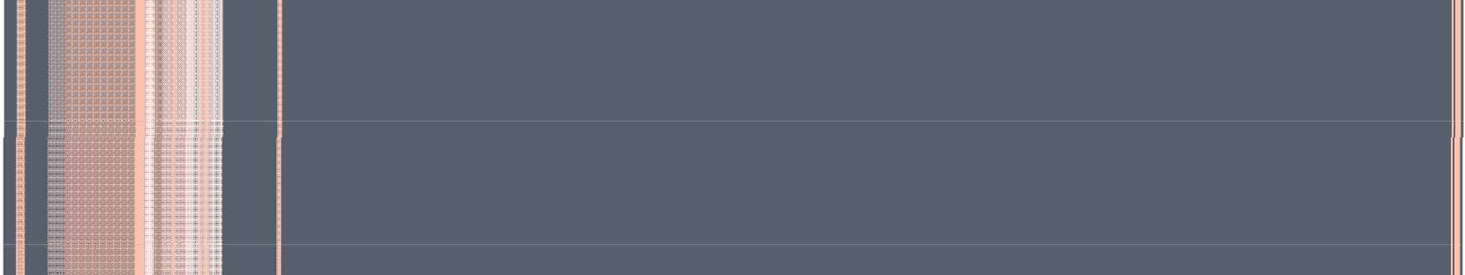
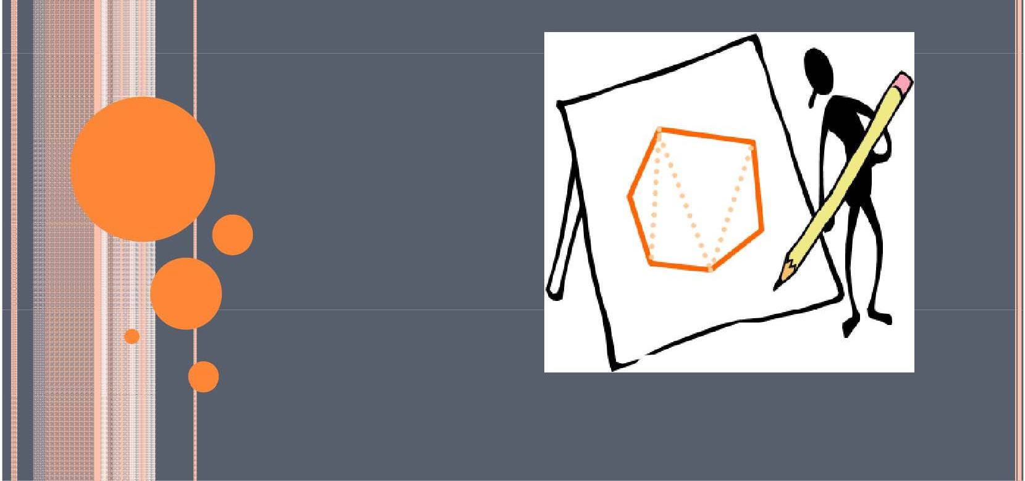
TRIANGLE DECOMPOSITION OF
CONVEX POLYGON

Slide 52
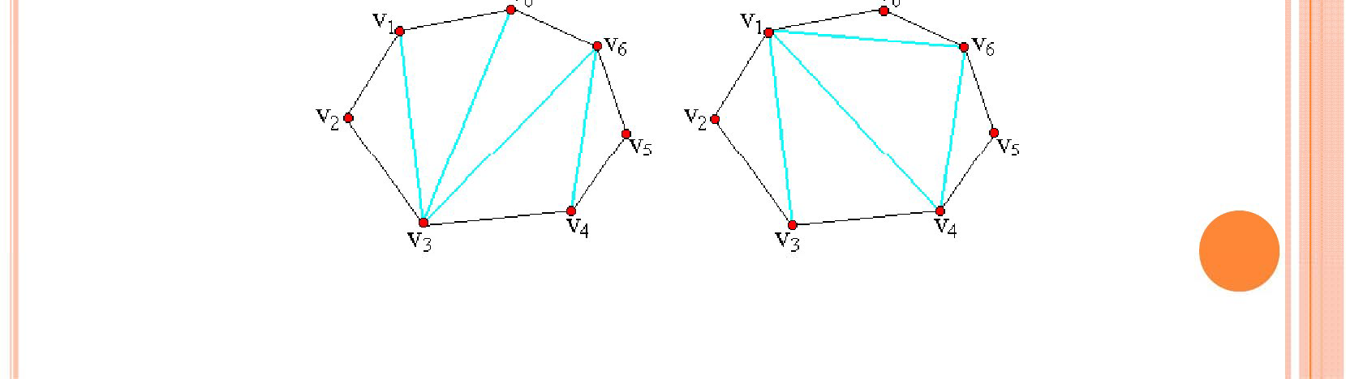
DEFINITION
Convex polygon P = {v₀ , v₁ ,..., v_{n-1}}
Triangle decomposition: chords set T that decompose polygon into disjoint triangle
We can improve that in a triangle decomposition of a n vertices convex polygon, there happened to be n-3 chords and n-2 triangles.

Slide 53
DEFINITION
Weighting function w
for example:
w(v_{i} v_{j} v_{k} ) = |v_{i} v_{j} | + |v_{j} v_{k}| + |v_{i} v_{k}|
Where |v_{i} v_{j}| is the Euclid distance between
v_{i} and v_{j}

Slide 54
DEFINITION
Optimal triangle decomposition
Input: polygon P and weighting function w
Output: triangle decomposition T, to minimize
Σ_{S∈ST} W (s)

Slide 55
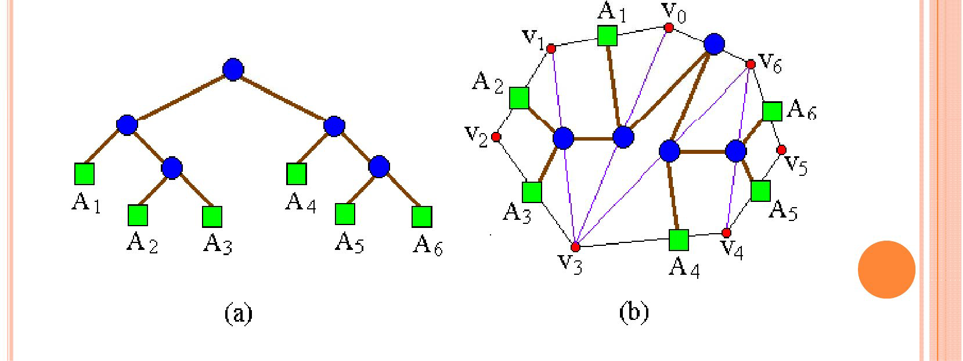
TRIANGLE DECOMPOSITION AND MATRIX-CHAIN-ORDER
A matrix chain is corresponding to a complete binary tree.
For example:
((A₁(A₂A₃))(A₄(A₅A₆))) is converted to a complete binary tree.

Slide 56
TRIANGLE DECOMPOSITION AND MATRIX-CHAIN-ORDER
Triangle decomposition of a n-vertices convex polygon is corresponding to a n-1 leaves complete binary tree.

Slide 57
CONSTRUCT OPTIMAL SOLUTION
It is coordinate with the Matrix-chain-Order. So modify Matrix-chain-order, we can construct optimal triangle decomposition.

Slide 58
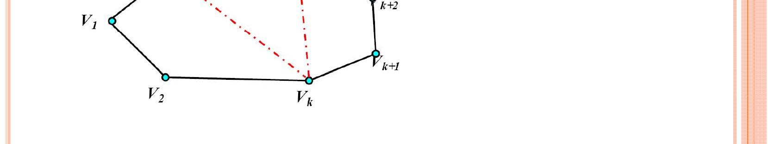
THE STRUCTURE OF OPTIMAL SOLUTION
P=(v₀,v₁,...,v_{n})is a n+1 vertices polygon
T_{p} is an optimal triangle decomposition, v_{k} is the decomposition point.
The structure of optimal solution
T_{P}=T(v₀ , ...,v_{k})∪T(v_{k} , ..., v_{n})∪{v₀v_{k} , v_{k}v_{n} , v₀v_{n}}

Slide 59
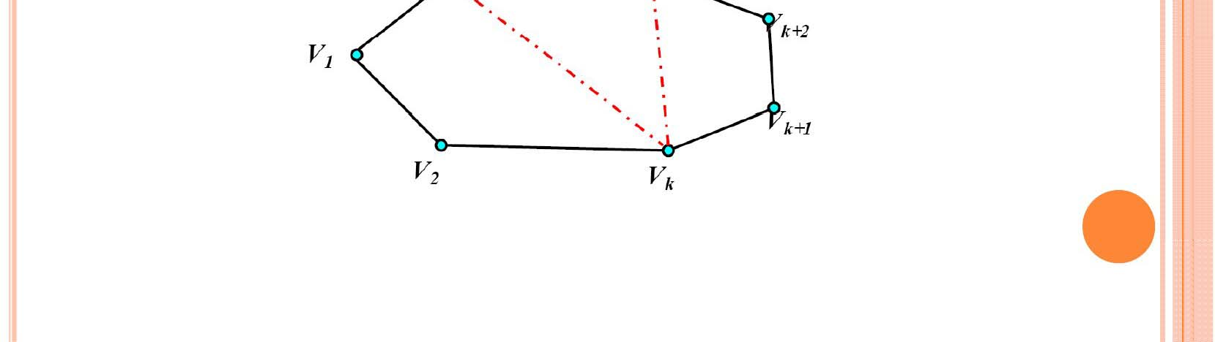
RECURSIVE SOLUTION
0 n = 1
^{t[1][n] =} min{t[1][k] + t[k + 1][ n] + w(v₀v_{k} v_{n} )} n＞1
1≤k<n

Slide 60
RECURSIVE SOLUTION
0 i = j
^{t[i][j] =} min{t[i][k] + t[k + 1][ j] + w(v_{i-1}v_{k} v_{j} )} i＜ j
i≤k<j
m[i, j] = 0
if i=j if i<j
m[i, j] = mini≤ k<j{m[i, k ] + m[k + 1, j] + pi -1 pk pj }

Slide 61
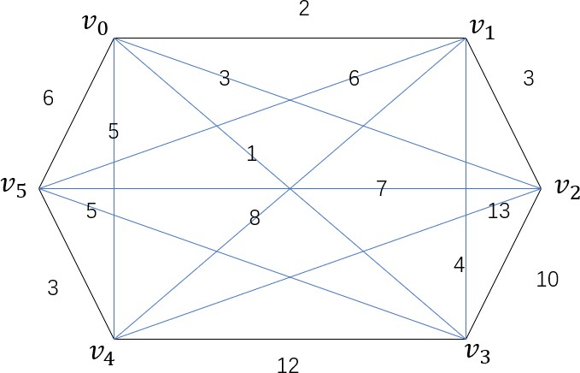
g[ ][ ]
 | 0 | 1 | 2 | 3 | 4 | 5
0 | 0 | 2 | 3 | 1 | 5 | 6
1 | 2 | 0 | 3 | 4 | 8 | 6
2 | 3 | 3 | 0 | 10 | 13 | 7
3 | 1 | 4 | 10 | 0 | 12 | 5
4 | 5 | 8 | 13 | 12 | 0 | 3
5 | 6 | 6 | 7 | 5 | 3 | 0
m[ ][ ]
 | 1 | 2 | 3 | 4 | 5
1 | 0
2 |  | 0
3 |  |  | 0
4 |  |  |  | 0
5 |  |  |  |  | 0
s[ ][ ]
 | 1 | 2 | 3 | 4 | 5
1 | 0
2 |  | 0
3 |  |  | 0
4 |  |  |  | 0
5 |  |  |  |  | 0

Slide 62
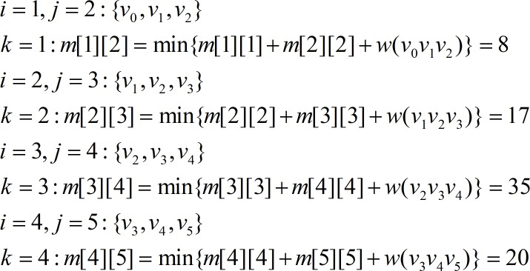
三个顶点：

Slide 63
m[ ][ ]
 | 1 | 2 | 3 | 4 | 5
1 | 0 | 8
2 |  | 0 | 17
3 |  |  | 0 | 35
4 |  |  |  | 0 | 20
5 |  |  |  |  | 0
s[ ][ ]
 | 1 | 2 | 3 | 4 | 5
1 | 0 | 1
2 |  | 0 | 2
3 |  |  | 0 | 3
4 |  |  |  | 0 | 4
5 |  |  |  |  | 0

Slide 64
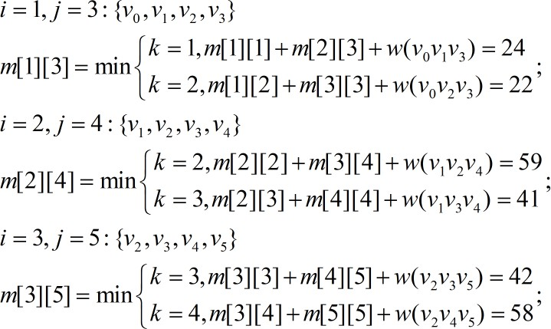
四个顶点：

Slide 65
m[ ][ ]
 | 1 | 2 | 3 | 4 | 5
1 | 0 | 8 | 22
2 |  | 0 | 17 | 41
3 |  |  | 0 | 35 | 42
4 |  |  |  | 0 | 20
5 |  |  |  |  | 0
s[ ][ ]
 | 1 | 2 | 3 | 4 | 5
1 | 0 | 1 | 2
2 |  | 0 | 2 | 3
3 |  |  | 0 | 3 | 3
4 |  |  |  | 0 | 4
5 |  |  |  |  | 0

Slide 66
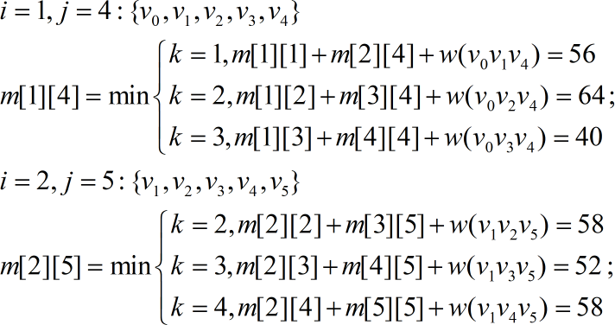
五个顶点：

Slide 67
m[ ][ ]
 | 1 | 2 | 3 | 4 | 5
1 | 0 | 8 | 22 | 40
2 |  | 0 | 17 | 41 | 52
3 |  |  | 0 | 35 | 42
4 |  |  |  | 0 | 20
5 |  |  |  |  | 0
s[ ][ ]
 | 1 | 2 | 3 | 4 | 5
1 | 0 | 1 | 2 | 3
2 |  | 0 | 2 | 3 | 3
3 |  |  | 0 | 3 | 3
4 |  |  |  | 0 | 4
5 |  |  |  |  | 0

Slide 68
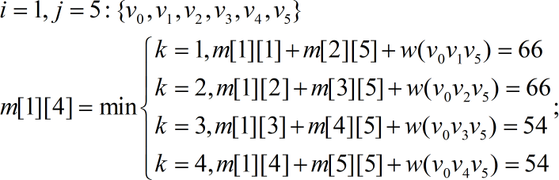
六个顶点：

Slide 69
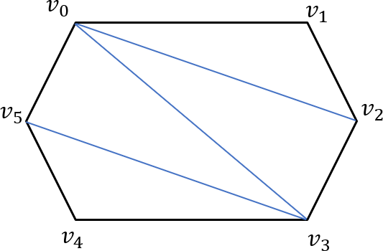
m[ ][ ]
 | 1 | 2 | 3 | 4 | 5
1 | 0 | 8 | 22 | 40 | 54
2 |  | 0 | 17 | 41 | 52
3 |  |  | 0 | 35 | 42
4 |  |  |  | 0 | 20
5 |  |  |  |  | 0
s[ ][ ]
 | 1 | 2 | 3 | 4 | 5
1 | 0 | 1 | 2 | 3 | 3
2 |  | 0 | 2 | 3 | 3
3 |  |  | 0 | 3 | 3
4 |  |  |  | 0 | 4
5 |  |  |  |  | 0

